Slide 1
DESIGN (ANTI-)PATTERNS
Decorator
Matúš Turčin
22.5.2019

Slide 2
WHAT ARE DESIGN PATTERNS
A software design pattern is a general, reusable solution to a commonly occurring problem. It is not a finished design that can be transformed directly into source or machine code. It is a description or template for how to solve a problem that can be used in many different situations. Design patterns are formalized best practices that the programmer can use to solve common problems when designing an application or system.
Types
Creational (singleton, builder, lazy init, abstract factory, object pool etc.)
Structural (adapter, bridge, decorator, facade, composite, proxy etc.)
Behavioral (iterator, strategy, template method, visitor, command, observer etc.)
Concurrency (thread pool, double checked locking, monitor object, reactor etc.)

Slide 3
DECORATOR
Definition
The Decorator Pattern attaches additional responsibilities to an object dynamically. Decorators provide a flexible alternative to subclassing for extending functionality.
When to use
You want to add responsibilities to individual objects dynamically and transparently, that is without affecting other objects
You want to add responsibilities to the object that you want to change in the future
When extension by static sub-classing is impractical.

Slide 4
DECORATOR
Additional information
Decorator classes mirror the type of the components they decorate (In fact, they are the same type as the components they decorate, either through inheritance or interface implementation.)
Decorators change the behavior of their components by adding new functionality before and/or after (or even in place of) method calls to the component
You can wrap a component with any number of decorators.
Alternative to subclassing for extending behavior. It offers better flexibility than inheritance
Allow add behaviour to class without modifying existing code
Composition and delegation can often be used to add new behaviors at runtime

Slide 5
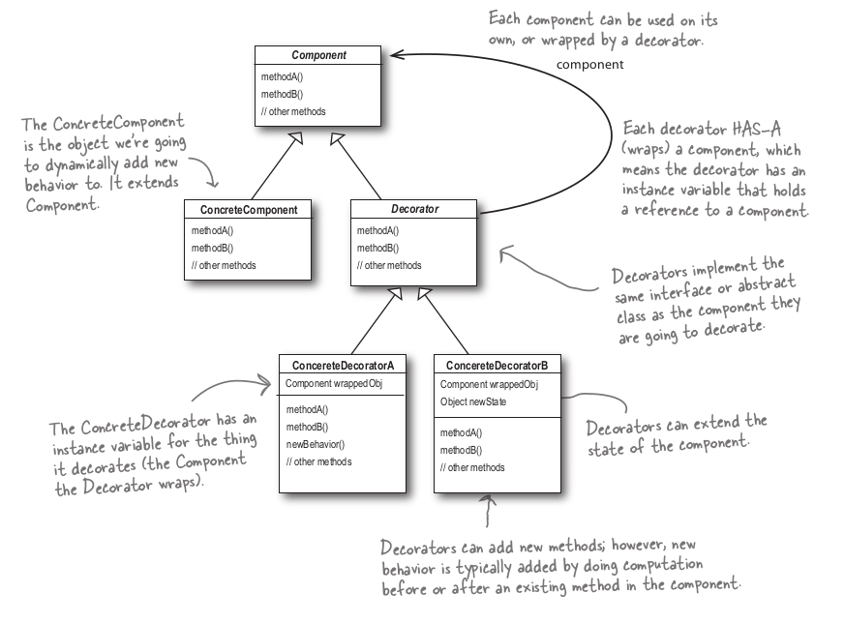
UML class diagram #1

Slide 6
DECORATOR
PROS/CONS
+ Alternative to subclassing for extending behavior. It offers better flexibility than inheritance
+ Great pattern for creating flexible designs and staying true to the Open-Closed Principle and Single Responsibility Principle
- Decorators can result in a large number of small classes in our design. It can be overwhelming to a developer trying to use the Decorator-based API
- Decorators can increase the complexity of the code needed to instantiate the component. (Instantiate not only the component, but also wrap it with who knows how many decorators.)

Slide 7
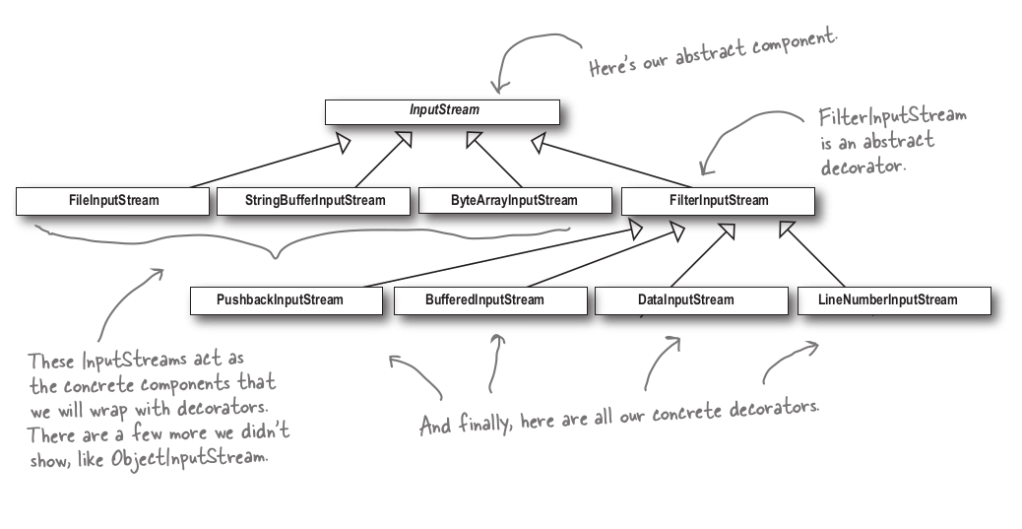
DECORATOR
Java API usage

Slide 8
DECORATOR
Example

Slide 9
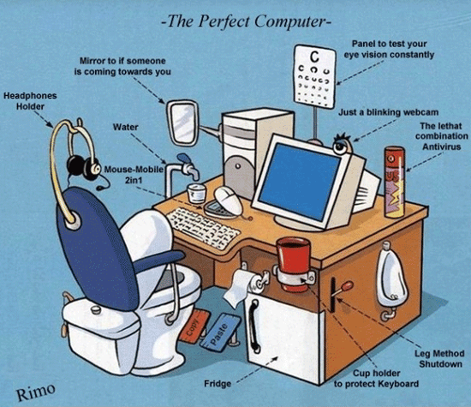
THANK YOU FOR ATTENTION

Slide 10
DECORATOR
Sources
O’REILY – Head first design patterns
https://en.wikipedia.org/wiki/Decorator_pattern
https://dzone.com/articles/decorator-design-pattern-in-java
https://www.gofpatterns.com/structural-design-patterns/structural-patterns/decorator-pattern.php

